Slide 1

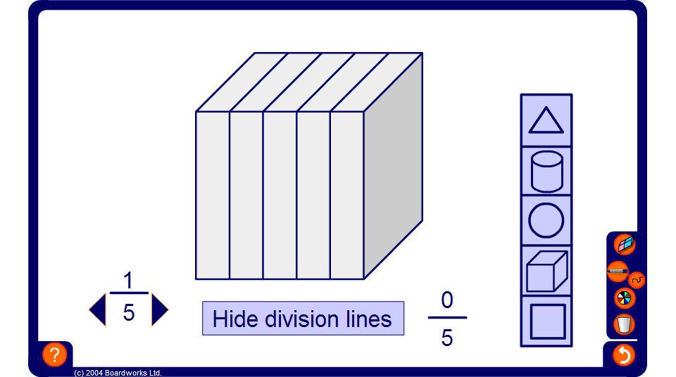


Fractions of shapes activity
Notes:
Start by selecting a shape.
Activity 1 – Shading in a given fraction
Choose how many parts to divide the shape into.
Ask a volunteer to shade in a given fraction of the shape. Repeat for other examples.
For example, select the square and divide it into 12 equal parts. Ask one volunteer to shade in ¹/₄, another to shade in ²/₃ and another to shade in ⁵/₆.
Activity 2 – Finding the fraction shaded
Choose another shape and shade in a random number of parts. Make sure that the numerator is hidden by clicking on it.
Ask pupils to tell you how many parts have been shaded.
This activity can also be used to introduce equivalent fractions.
Extend this activity by hiding the division lines and asking pupils to estimate the fraction shaded.

